Slide 1
INDOOR POSITIONING SYSTEM USING DEEP LEARNING
Clyde Noronha
Mustafa Zaki
Shane Gracias
Ruman Mulla

Slide 2
Objective
The objective of this project is to provide the accurate, real-time indoor location of a user using deep learning, with the help of the accelerometer and gyroscope sensors available in smartphones.

Slide 3
Introduction
Global Positioning Systems (GPS) are limited to an accuracy of up to 5m, hence are not helpful indoors.
Indoor Positioning Systems (IPS) are a solution to locate oneself indoors.
Several approaches such as WLAN, Bluetooth, Geomagnetic Fingerprinting and Inertial Sensors.
Our approach is based on inertial sensors present in smartphones, using deep learning to improve the accuracy.
It is purely software based, and requires the user to just download an application and use it.
Significant applications include personal indoor navigation, healthcare monitoring and security.

Slide 4
LITERATURE
SURVEY

Slide 5
Robust Indoor Positioning Provided by Real-Time RSSI Values in Unmodified WLAN Networks. [1] – S. Mazuelas et al, IEEE, November 2009
OVERVIEW
Received Signal Strength (RSS) refers to the strength of the signal as it traverses between the device and the Access Point (AP).
Distance between the device and the APs is estimated using only the RSS values obtained at that point.
Using estimated distance from at least 3 APs, trilateration is performed and the current location of the device is found.
LIMITATIONS
Hardware Requirements
RSS Fluctuation
Relatively Inaccurate

Slide 6
AMID: Accurate Magnetic Indoor Localization Using
Deep Learning. [2] - N. Lee et al, sensors, May 2018
OVERVIEW
In this method magnetic sensor data is collected at each point in a room using a robot.
Peaks in this data are taken as landmarks.
These landmarks are stored and used for data labelling in the classification step.
The model is trained to identify these landmarks.
The final trained model is used to identify the robot’s location by comparing it to the landmarks.
LIMITATIONS
Long-term variation
Presence of personal metallic objects
Presence of furniture

Slide 7
Improving Indoor Localization Using Bluetooth Low
Energy Beacons. [3] - P. Kriz, F. Maly, K. Tomas. Mobile Information Systems, April 2016
OVERVIEW
A combination of WiFi APs and Bluetooth beacons are used to localize the device.
In the first step, a fingerprint of a given place was created and stored in the database.
In the second step the object was localized by comparing the measured fingerprint with other fingerprint in the database and choosing the most similar fingerprint using KNN algorithm.
LIMITATIONS
Additional Hardware cost of using Bluetooth Low Energy Beacons and WiFi Transmitters.
The range up to which Bluetooth can effectively operate is approximately 30 m.
Inefficiency in relatively larger indoor spaces increases due to the positioning of the routers.

Slide 8
NEURAL NETWORKS

Slide 9
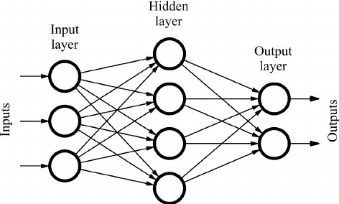
Neural Networks
Conventional Feed Forward Network
The connections between the input nodes and output nodes do not form a cycle.
The information moves in only one direction, i.e. forward from input nodes, through the hidden nodes and to the output nodes.

Slide 10
Limitations of Feed Forward Neural Networks
Not designed for sequences / time series data, hence the results with time series data are bad.
Requires fixed size input and fixed output.
Does not model memory.

Slide 11
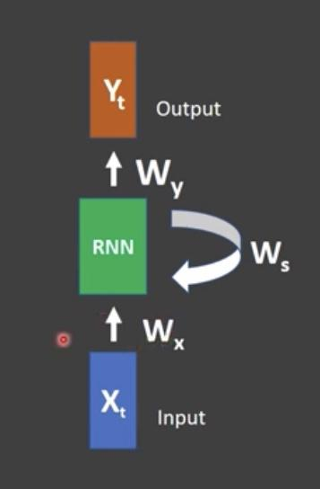
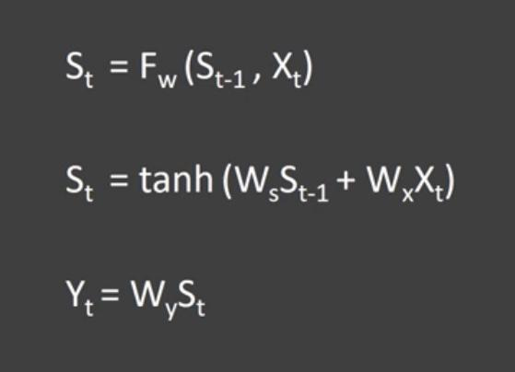
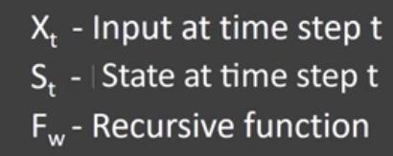
Recurrent Neural Networks
Recurrent Neural Networks are a type of neural network designed for capturing information from sequence / time series data. The output of the previous RNN is given as the input to the next RNN along with the main input.

Slide 12
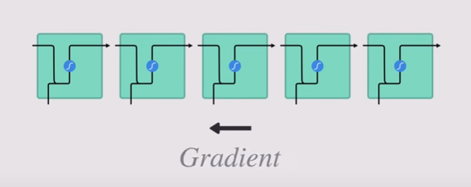
Limitations of RNN
Vanishing Gradient Problem
Gradient
During back propagation, gradient for each node is calculated using gradient for previous layer.
Therefore if the gradient in the previous layer is small, the gradient in the current layer ll be even smaller.
New Weight = Weight - Learning Rate * Gradient
2.0999 = 2.1 - 0.001
The weights are barely adjusted in the earlier layers causing it not to learn.

Slide 13
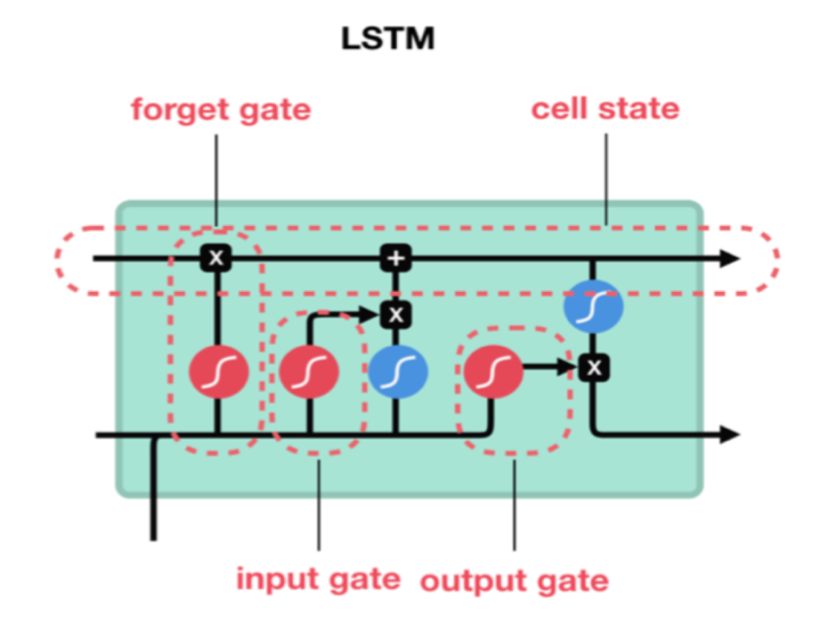
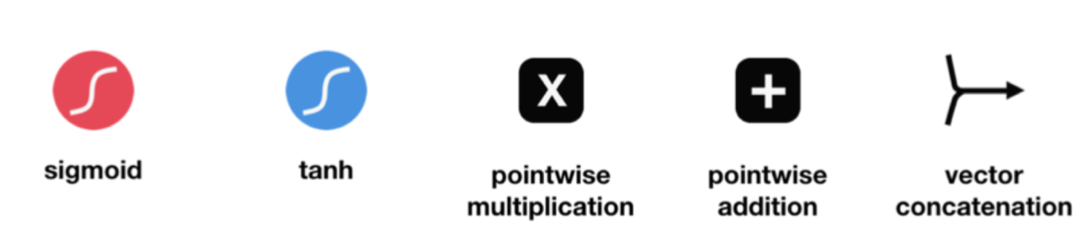
Long Short Term Memory (LSTM)

Slide 14
PROPOSED WORK & IMPLEMENTATION

Slide 15
Requirements
Software
Anaconda
Jupyter Notebook
Tensorflow
Python
Libraries
Pandas
NumPy
SciPy
Mathplotlib
Android Studio
Java
XML
Hardware
Smartphone
Accelerometer Sensor
Gyroscope Sensor
Macbook Pro
CPU: 2.5 GHz Quad-Core Intel Core i7
GPU: Intel Iris Pro

Slide 16
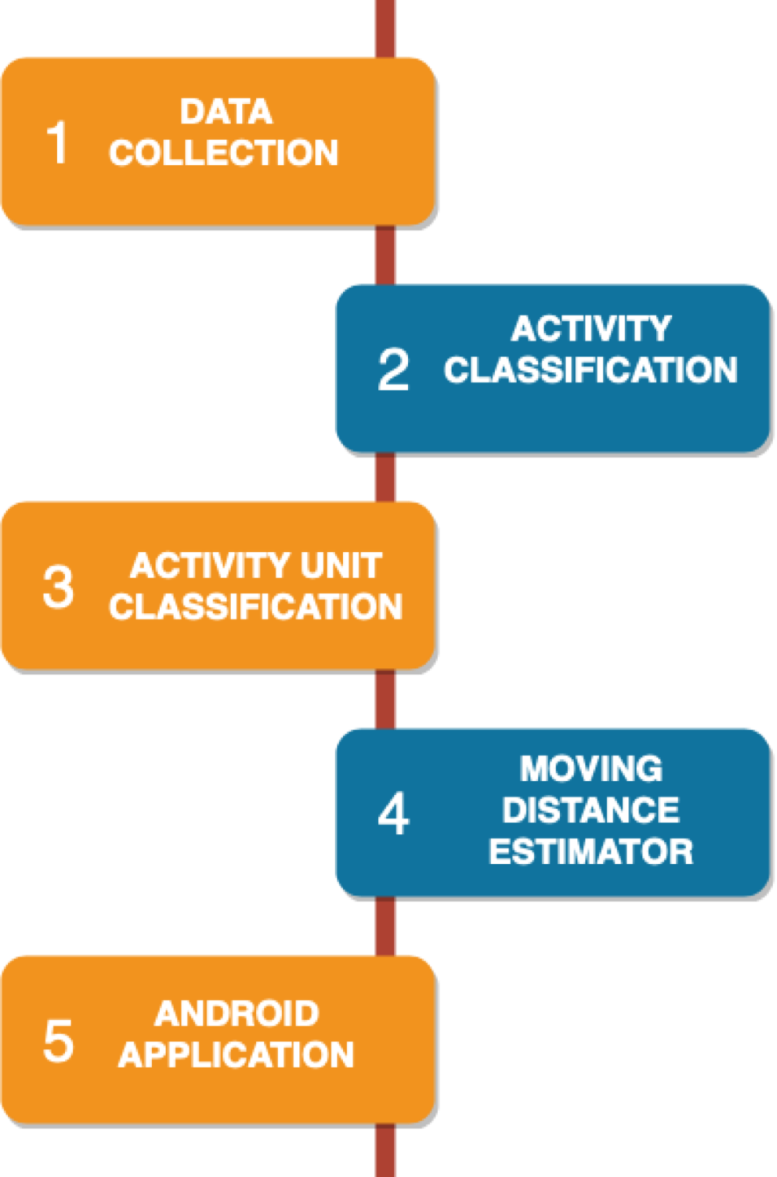
Level 0 Design Flow Diagram.

Slide 17
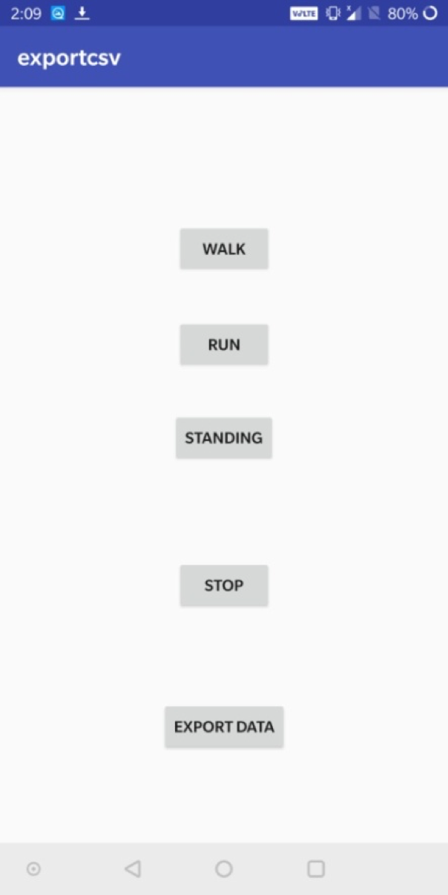
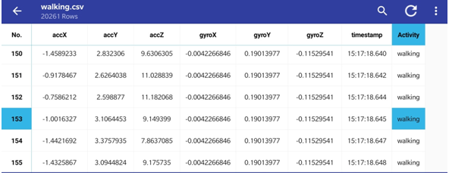
Data Collection
We built a simple app using Android Studio to collect accelerometer and gyroscope sensor data and store it in a .csv file.
Three buttons are provided to collect the data according to the activity being performed. The data is recorded with a frequency of 10Hz. Once the data is recorded, we export it to a file.

Slide 18
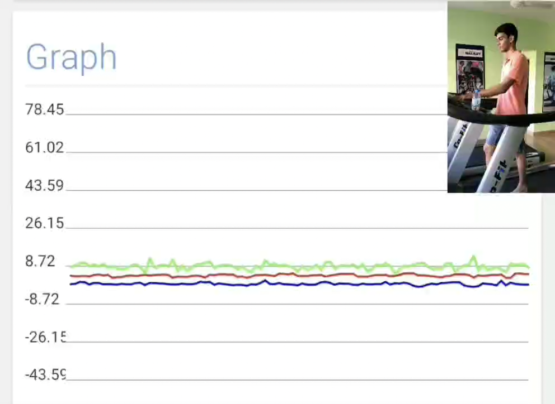
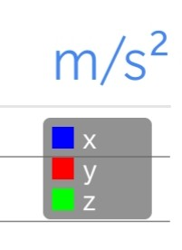
Collection of Accelerometer Data for Walking and Running

Slide 19
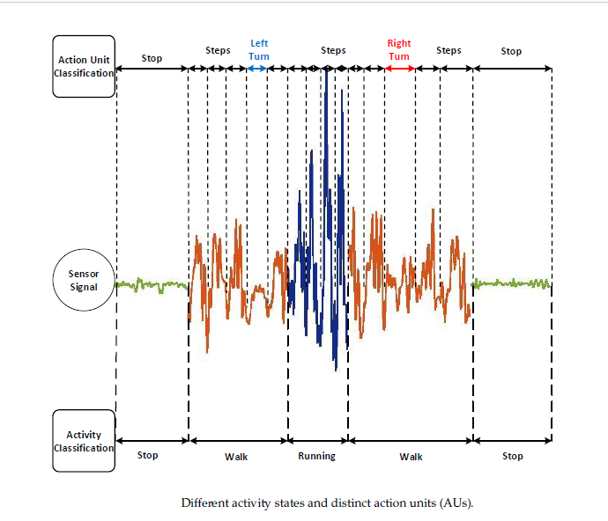
Different Activities

Slide 20
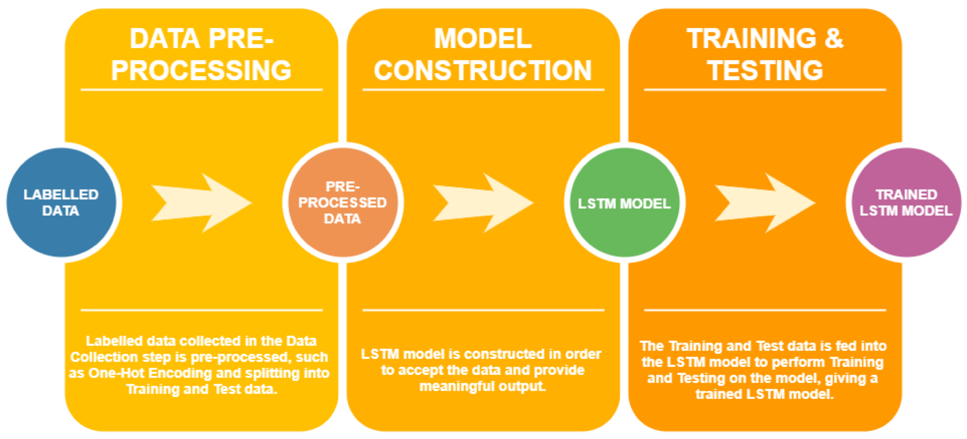
Activity Classification
The Activity Classification phase classifies the activities being performed by the user (Walking, Running, Standing) using an LSTM.
We have implemented an LSTM that uses a dataset of 10,98,207 rows and 6 columns (Activity, accX, accY, accZ, timestamp and user) to classify the user activity (Walking, Jogging, Upstairs, Downstairs, Sitting and Standing). The implementation is divided into 3 steps: 1. Data Pre-processing 2. Model Construction 3. Model Training & Testing
Level 1 LSTM Design Flow Diagram

Slide 21
1. Data Pre-processing The data collected has to be pre-processed for training since the LSTM model expects fixed-length sequences as training data. Each sequence of data contains 200 training examples. The data has been transformed to include only the accelerometer x-axis, y-axis and z-axis data i.e. 3 features.
One-Hot Encoding i.e. converting the activities which are categorical data into binary vector arrays, is also done.
The data is then split into training (80%) and test (20%) data.
2. Model Construction The LSTM model contains 2 LSTM layers stacked on top of each other with 64 hidden units each. It consists of 6 class labels (Walking, Jogging, Sitting, Standing, Upstairs, Downstairs), with the inputs being the accelerometer data (x-axis, y-axis and z-axis). We use the LSTM model to predict the output, and use the softmax function over it. We then find the loss and backpropagate it in order to optimize the model.

Slide 22
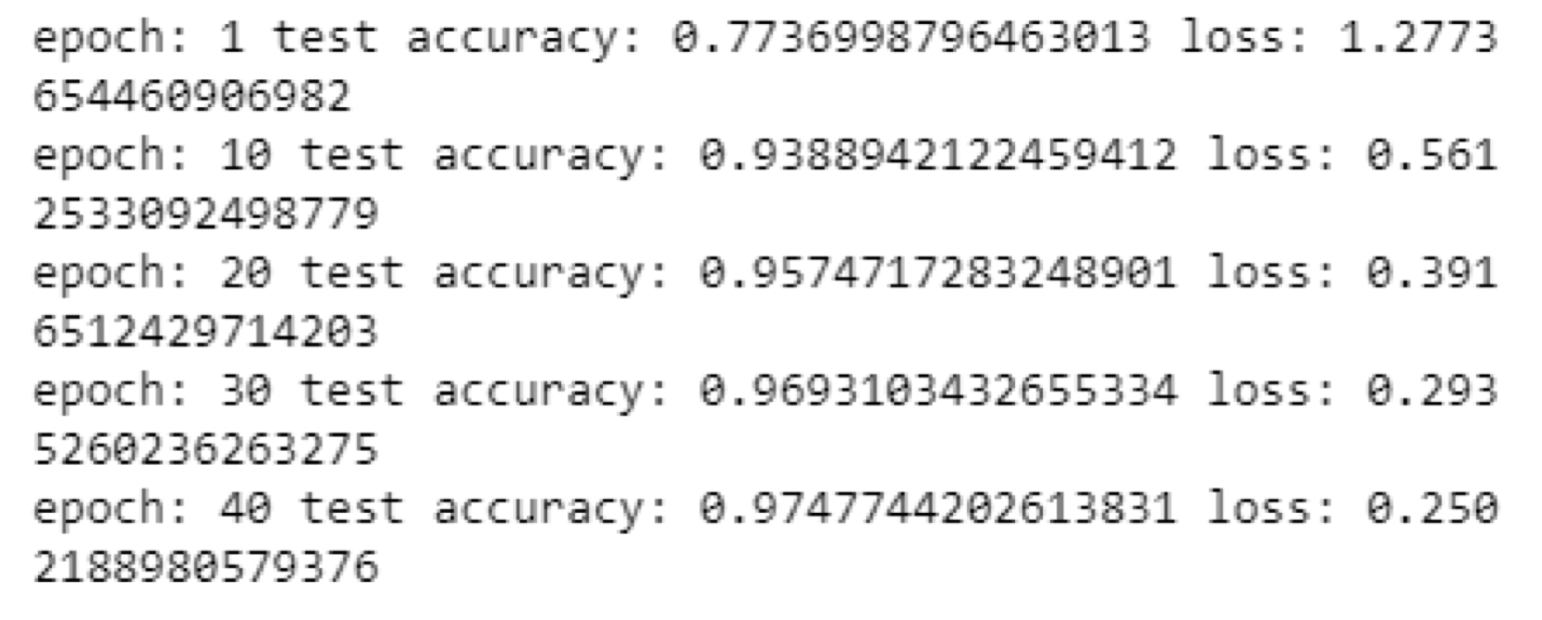
3. Model Training & Testing
Training and Testing was performed on the model for 40 epochs with a batch size of 1024. We feed arrays of data obtained in previous steps into the training and testing inputs for the model. The output is given as the train and test loss and accuracy. This gives us a working model that we can use for further steps.
OUTPUT

Slide 23
Activity Unit (AU) Classification
Data will be collected for Left Turn, Right Turn, Short Step, Normal Step and Long Step.
This data will be fed into an Activity Unit Classification LSTM similar to the Activity Classification step.
This step is included in order to improve the classification accuracy before it is input into the Moving Distance Estimator.
It will include the following steps, as per the Level 1 DFD depicted earlier:
Data Pre-processing
Model Construction
Training & Testing

Slide 24
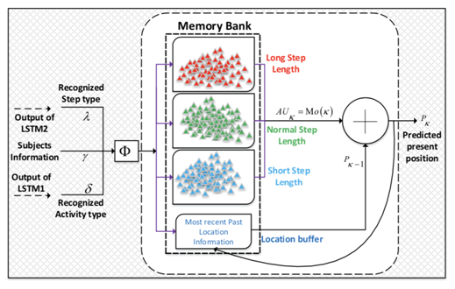
Moving Distance Estimator
There will be 3 memory banks: Long Step Length, Normal Step Length, Short Step Length, and a Location Buffer.
If AU is Left Turn or Right Turn, it adds 90 degrees to the trajectory of the user.
If AU is Long Step, Short Step, Normal Step, it will compute the step length as follows:
‘Ground truth’ values will be stored in memory banks.
Estimator picks the mode of the memory bank of the particular step type as obtained from the LSTMs.
The current position of the user will be updated by adding the estimated step length to the previous position of the user.
Previous position will be stored in the location buffer.

Slide 25
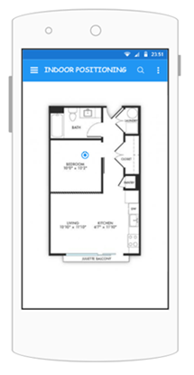
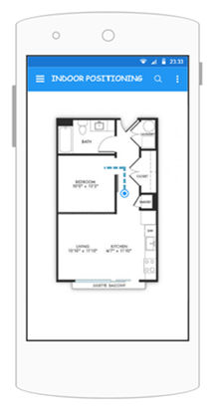
Android Application
User selects starting position
User moves and system updates position in real time

Slide 26
Concluding Remarks
We have performed a literature survey and detailed our findings.
We have proposed the work to be done with the help of Design Flow Diagrams.
We have implemented Data Collection and Activity Classification modules.
We have created an android app to perform Data Collection seamlessly.
We have built an Activity Classification LSTM that outputs correct activities with 97% accuracy.
We plan on implementing the Activity Unit Classification, Moving Distance Estimator, and Android Application module in this coming semester.

Slide 27
Bibliography
S. Mazuelas, A. Bahillo, R. Lorenzo, et al, 2009, “Robust Indoor Positioning Provided by Real-Time RSSI Values in Unmodified WLAN Networks”, IEEE Journal of Selected Topics in Signal Processing, November 2009.
N. Lee, S. Ahn, and D. Han, 2018, “AMID: Accurate Magnetic Indoor Localization Using Deep Learning”, sensors, May 2018.
P. Kriz, F. Maly, and K. Tomáš, 2016, “Improving Indoor Localization Using Bluetooth Low Energy Beacons”, Mobile Information Systems, April 2016.
G. Hussain, M.S. Jabbar, J.D. Cho, and S. Bae, 2019, “Indoor Positioning System: A New Approach Based on LSTM and Two Stage Activity Classification”, electronics, March 2019.

